Slide 1
Project Springwater
C walker, c boucher, c cooper, d woodward,
t Stacey, a butcher, j forster & G Westwater

Slide 2

Initial Investigation
NB Gardens
Traditional Catalogue Company
Interviews
Senior Management
Lower Level Employees
Architect the Business

Slide 3

Why are we here?
OPS: Order Placement System
Customer Orders
Web Front End
WOTS: Warehouse Order Tracking System
Add Orders to Queue
Retrieve Order Statuses

Slide 4
As a visitor I want to be able to enter my details so I can become a customer
As a visitor I should be able to browse though a list of products
As a customer I want to be able to check my credit
As a customer I want to be able to place an order for the items in my basket
As an inventory manager I want to see the daily stock report
As an inventory manager I want to be able to make purchase orders of low and new stock lines

Slide 5
Database Structure

Slide 6
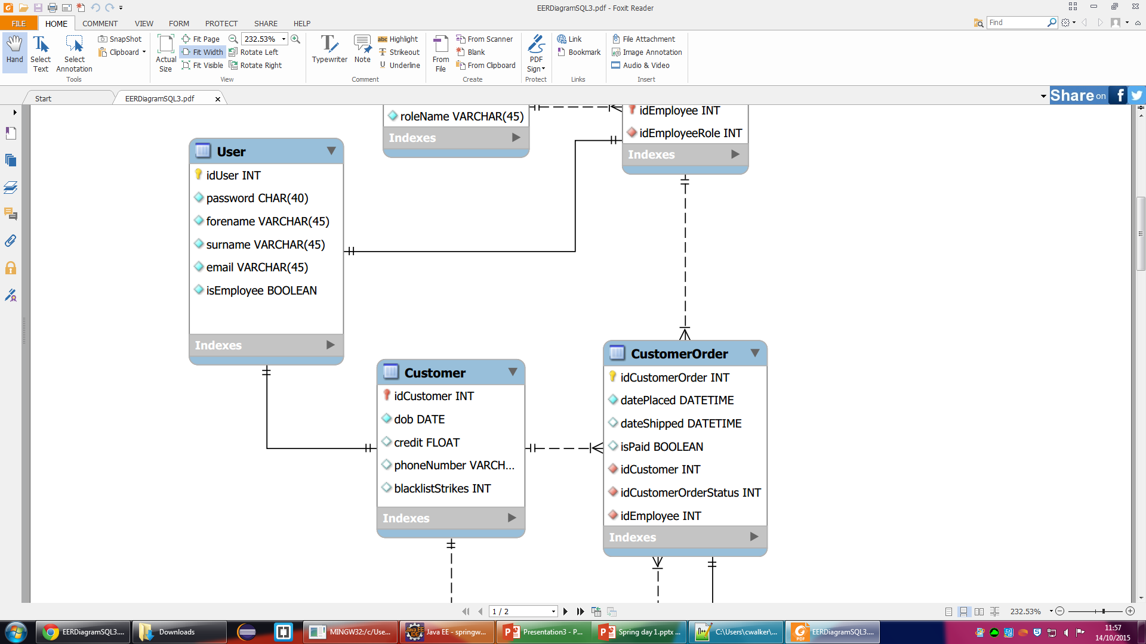
As a visitor I want to be able to enter my details so I can become a customer
Visitor
Customer -
idUser
First Name
Last Name
Email
Password
DOB
Phone Number

Slide 7
MySQL + Mongo DB
Mongo DB
Pros
JSON Based
Flexible
Examples
Item Store
MySQL
Pros
Rigid Data Structure
Relational
Examples
Customer Orders

Slide 8
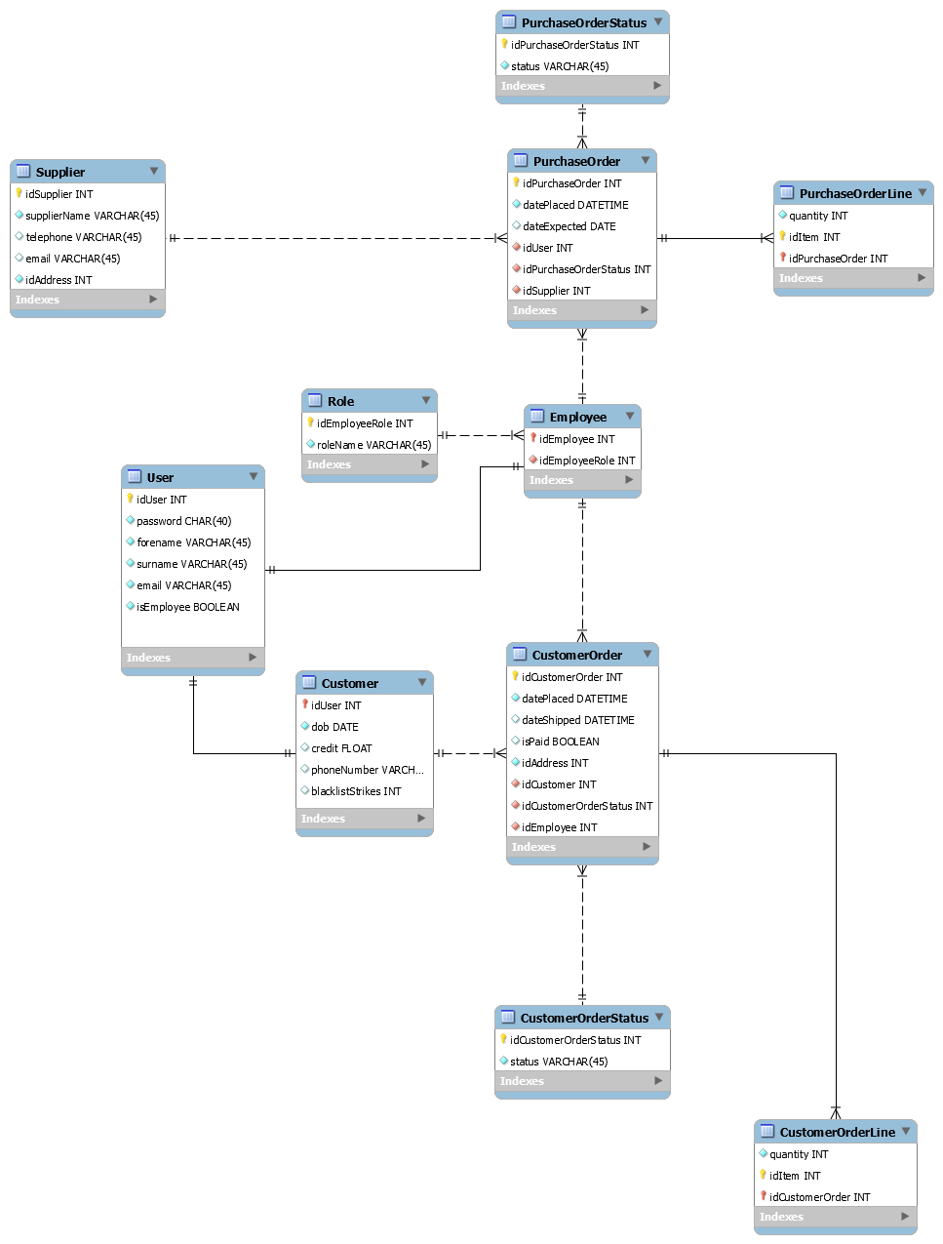
ERD: Entity Relationship Diagrams
MySQL ERD

Slide 9
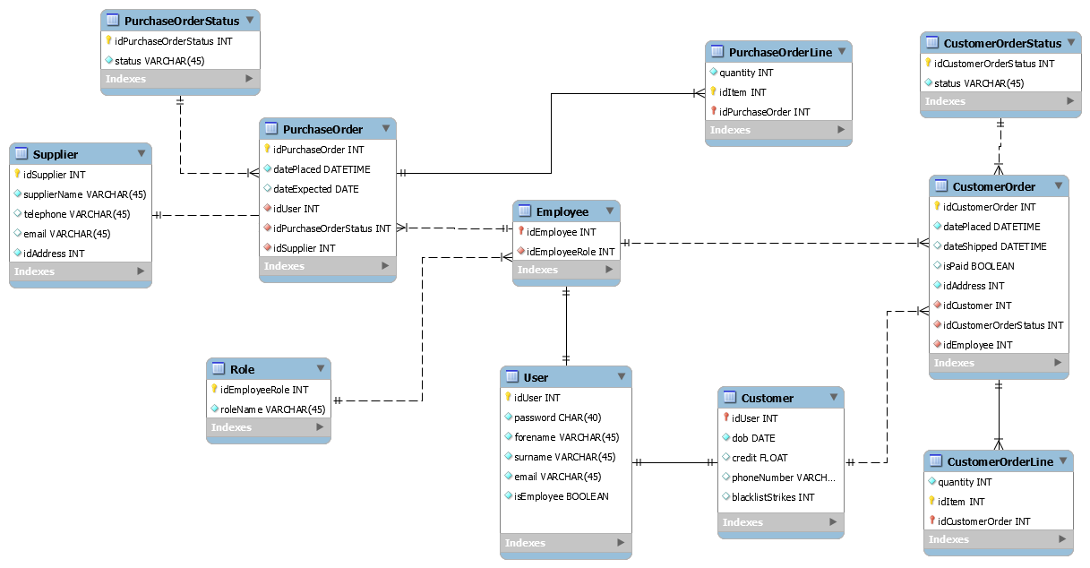
ERD: Entity Relationship Diagrams

Slide 10
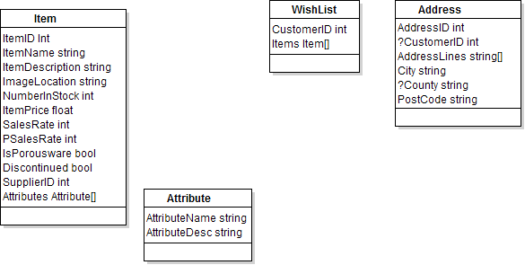

ERD: Entity Relationship Diagrams

Slide 11
System Design

Slide 12
Development Practices
Agile Development
Scrum Meetings
Sprints
Multiple Projects
Sprint Retrospectives
Demo Soon!

Slide 13
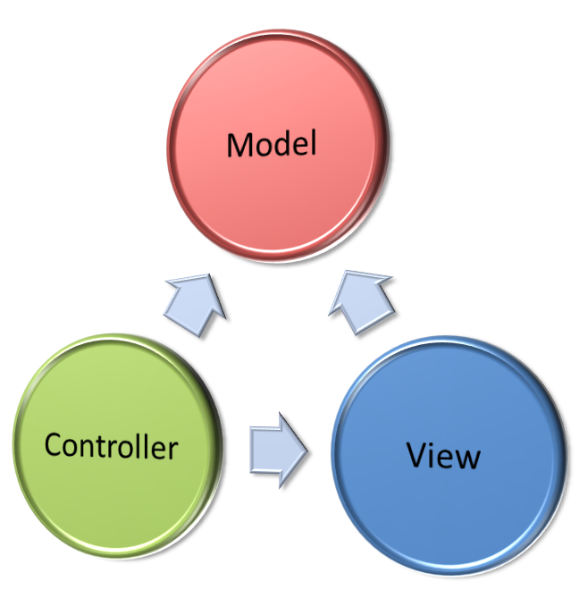
Design Patterns
MVC
Model
View
Controller
Objects First

Slide 14

Utilised Tools
Development Environment
Maven
Git
Jira
Docker
Libraries and Frameworks
Spring
Bootstrap
Swing

Slide 15
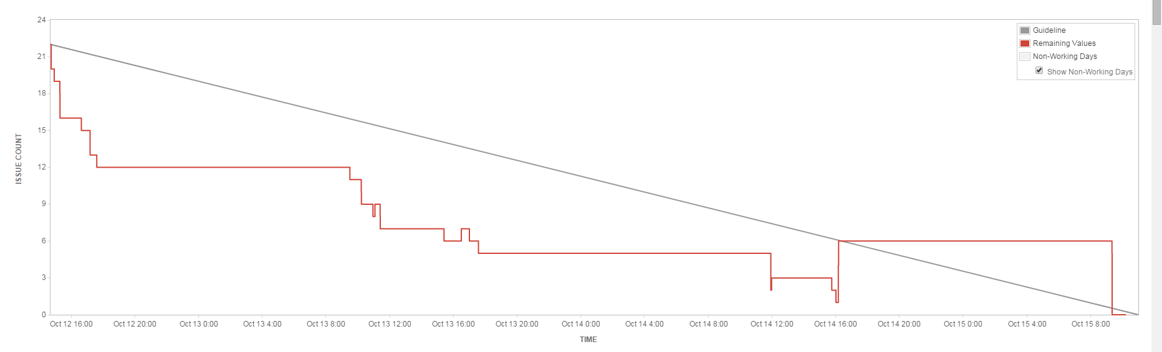
Issue Count

Slide 16
Class Diagrams
HTML Web App

Slide 17
Class Diagrams
Java Desktop App

Slide 18
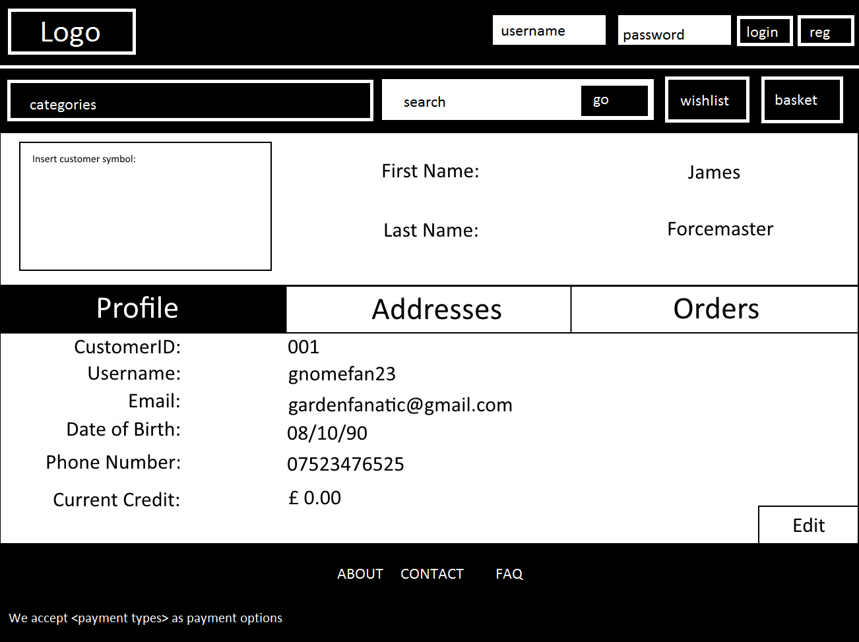
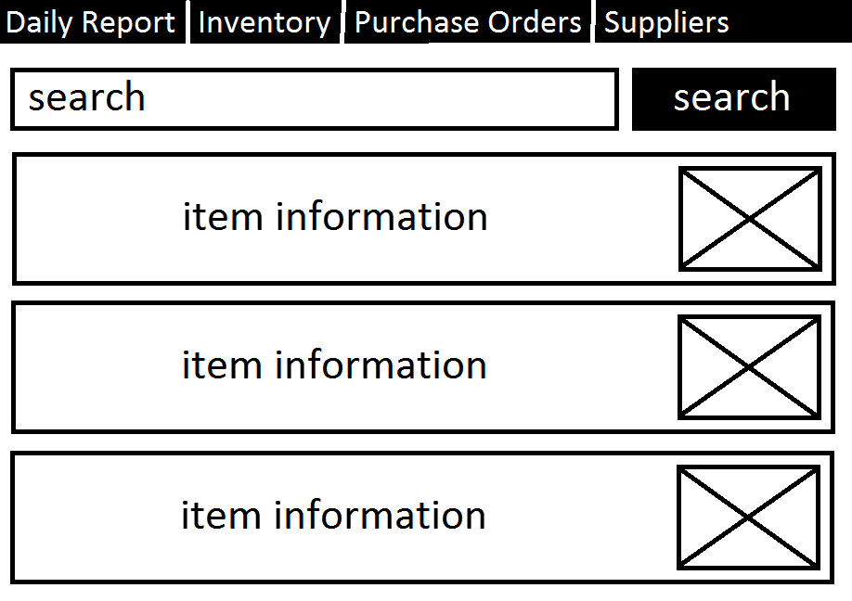
Wireframes
Example wireframes from the web app and desktop respectively

Slide 19
Live Demo
Java desktop app & HTML web app

Slide 20
Questions?

